Slide 1
Global Student Teaching

Slide 2
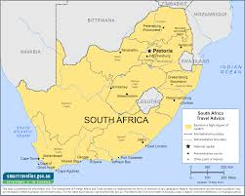
Video South Africa Video

Slide 3
The Basics
8 weeks (First half of student teaching semester)
Return to US and teach in a public school
Live in apartment in the city or near the school
Opportunity to travel on the weekends
Travel with at least one other TCNJ student

Slide 4
The Schools
English speaking international schools with American curriculums
Staff: mostly American, sometimes British and/or Australian teachers, sometimes local teachers
Students: depends on school- some are mostly American, some have more local children
Ex: American Overseas School of Rome- aims for 1/3 American students, 1/3 Italian and 1/3 from other countries

Slide 5
Most frequently asked question: Does it look good on a resume? YES!

Slide 6
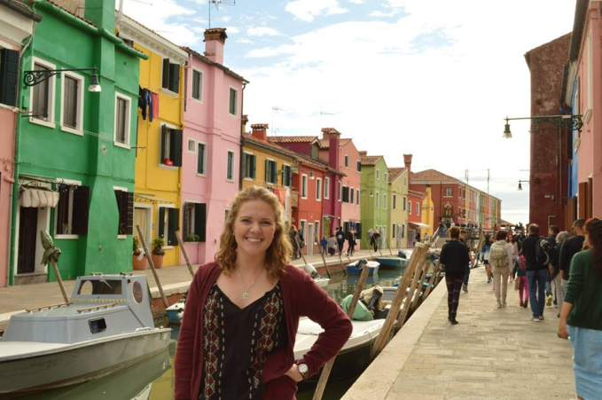
Costs and Housing
$300 fee
TCNJ faculty help with finding housing
Travel with at least one other student
Housing cost varies
Rome- $1400 for two months,
Prague- $1100 for two months
South Africa-$450 for two months

Slide 7
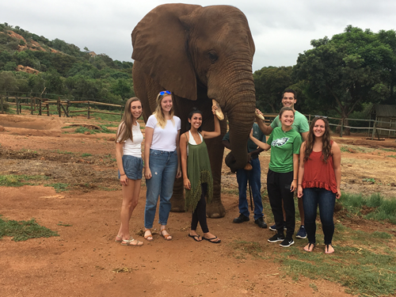
Financial Aid
Tuition and housing/living expenses covered by financial aid
Living on campus: credit for the quarter
Living at home during second half of Clinical II/Student Teaching

Slide 8
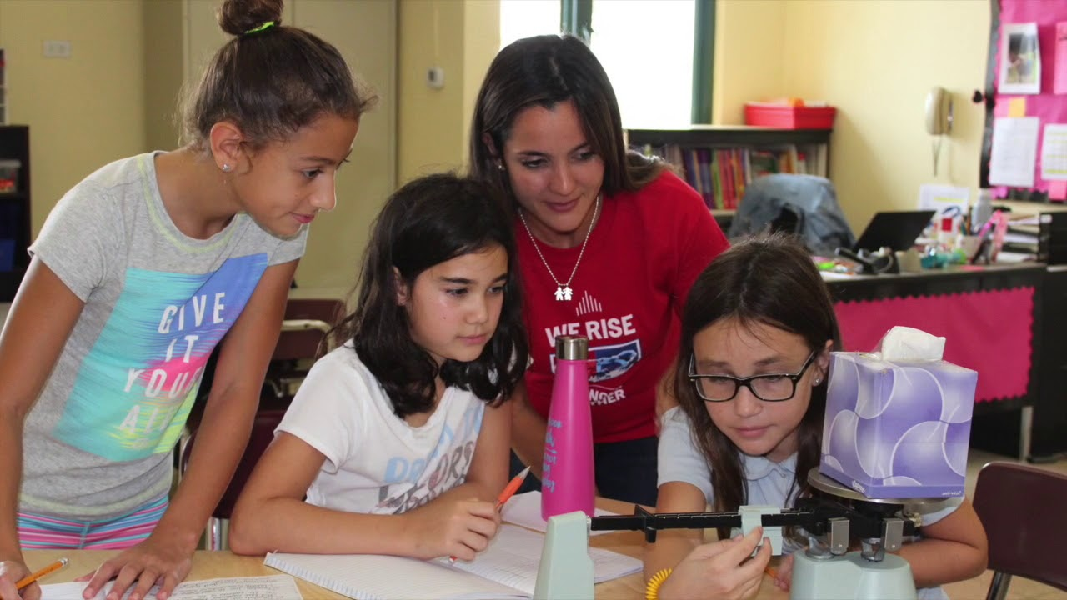
Overall Cost
Most students report that they spend between $4,000 and $5,000 depending the site and amount of extra travel
BUT costs above the amount to stay home are much lower (flight, extra travel)
Costs incurred during global or domestic:
Housing
Food
Transportation

Slide 9
Cost Comparison: On campus housing
GST Costs: Rome
On campus housing
Flight= $800
Housing= $1400
Transportation=$85
Groceries=$500
Health insurance=$120
TOTAL without weekend trips=$2905
Additional for weekend trips: $2000
Transportation to school= $346
30 miles/day for 7 weeks x .33
Room and board= $3519
Room=$4,757
Meal plan B= $2,280
Total= $7,038
Divided by 2 (credit given for 8 weeks away)=$3519
Total= $3,865

Slide 10
Total cost for semester living on campus:
GST plus second half on campus:$6770
(without weekend trips)
$2905 while abroad
$3865 second half
Full semester on campus: $7,730

Slide 11
Cost Comparison: Off campus
GST Costs: Finland
OFF campus housing for 2 months
Flight= $900
Housing= $1500
Transportation=$250
Groceries=$300
Health insurance=$120
Off campus rent while abroad: $1200
TOTAL without weekend trips=$4,270
Additional for weekend trips: $1200
Transportation to school= $346
30 miles/day for 7 weeks x .33
Room and board= $1700
Room=$1,200
Meals: $500
Total= $1,700
Total= $2,046

Slide 12
Total cost for semester living off campus:
GST=$6316
$4270 while abroad
$2046 second half
Not GST= $4,092
Housing and transportation

Slide 13
Living at family home after return?
Cost while abroad:
(without weekend trips)
$2905
If lived on campus for full semester= $7,730
Savings for living at home=? Depends on food and transportation

Slide 14
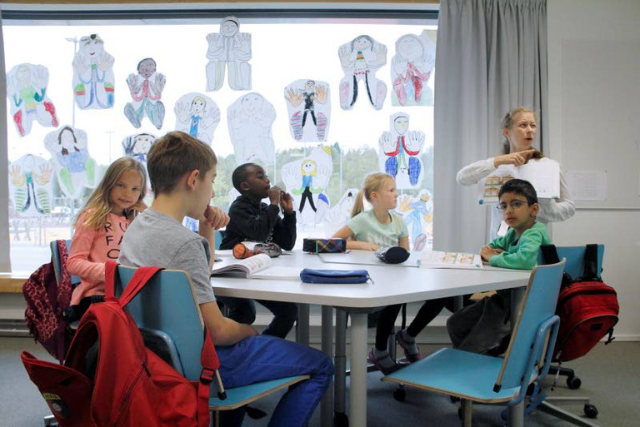
Scholarships
School of Education GST Scholarship
EOF: Let the program know you are applying
Phi Kappa Phi Study Abroad grants
Morton Winston Scholarship for Study Abroad (TCNJ)
Gilman Scholarships
Eligible if you receive a federal Pell Grant
Preference given to certain regions, including South Africa and Bangkok
Awards up to $5,000

Slide 15
Application
Process:
January 30th: deadline for application
$300 check not cashed until accepted
Physical form not due until prior to departure
February/early March: interviews
You will be contacted by the STEP Office
Early March: approval from departments/clinical I professors
Mid-March: notification
Late March: roundtable meeting with former GSTs

Slide 16
References
Ask a professor who has seen you teach in a practicum
May turn in application while waiting for references

Slide 17
Clinical Approval
Students’ acceptance may be rescinded if the Clinical I professor feels it is best that they remain in NJ to complete Clinical II.

Slide 18
Choosing a site
Costs can vary
Advantages of different sites
Be flexible!

Slide 19
Possible Sites for Fall 2020
Johannesburg
Bangkok
Madrid
Tangier, Morocco
Carinthia, Austria
Prague
Dublin
Rome
Espoo, Finland
The Hague
Puerto Rico
Tokyo

Slide 20
Possible Sites for Spring 2021
South Africa
Bangkok
Madrid
Morocco (Tangier)
Udine, IT
Trieste, IT
Austria
Dublin
Rome
Finland
The Hague
Amsterdam
Puerto Rico

Slide 21
Requests for travel companions
You may request to travel with a friend. We will do our best to place you together. BUT it may not be possible.
You must be FLEXIBLE

Slide 22
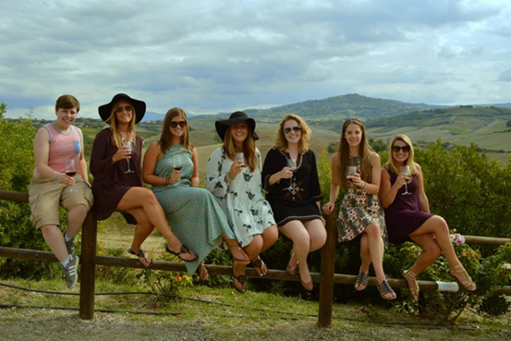
If you are accepted:
Meet with students who have returned in March at roundtable
Several meetings with TCNJ faculty member site supervisor
Communicate with cooperating teacher in placement abroad
Meet with capstone professor

Slide 23
While you are there…
Work with Cooperating Teacher
Communicate with TCNJ faculty on campus with weekly reflections
Submit two video lessons for feedback
TCNJ faculty visit and observe at least two lessons
Keep in touch with capstone professor

Slide 24
WORK HARD
Play Hard

Slide 25
Professionalism & Expectations
Responding to emails and timeliness
This is a professional experience
Teaching is #1 priority
Do NOT expect to leave school early or come in late because of travel
Balance travel/work/rest

Slide 26
Miscellaneous Stuff….
SPED- complete elementary placement abroad
Other K-12 certification areas: placed domestically based on placement abroad
Domestic placements are not requested until global placement confirmed
edTPA: complete in domestic placements (usually)
BE PATIENT

Slide 27
Review of forms
http://step.tcnj.edu/forms/

Slide 28
Questions?
Eileen Heddy
heddy@tcnj.edu
Cynthia Fulford
step@tcnj.edu

